Slide 1

Stock Research Application Project Progress Report #1
Group 5

Slide 2

Microservices (Features)
User Database Service
Stock Analysis Service
Market News and Sentiment Service
Portfolio Management Service
Alert and Notification Service
Earnings Call Service

Slide 3

Two Peaks Requirement Approach
Peak 1 — Requirements Definition (Iteration 1)
Capture core functional and quality requirements
Define scope, constraints, and success metrics
Align all group members on vision and priorities
Outcome: Stable foundation for design and architecture decisions
Peak 2 — Requirements Refinement (Iteration 3)
Evolve requirements based on feedback and testing
Adjust features and performance targets during iterations
Maintain traceability between goals and implementation
Outcome: Flexible, development-informed improvements

Slide 4
Architecturally Significant Requirements
Data persistence redundancy – Add replicated databases or multi-region storage.
Authentication and access control – Integrate identity management.
Low latency requirements – Employ caching, and optimized data pipelines.
Fault tolerance and retry logic – Implement message queues, retries, and failover systems.
Event-driven alert system – Use pub/sub or event bus for real-time notifications.
High scalability – Use microservices, load balancers, and auto-scaling.

Slide 5

User Database Service
Functional Requirements:
FR1_1: Store user authentication data (username, password, email, etc.).
FR1_2: Store user portfolios and manage personal holdings.
FR1_3: Expose secure endpoints for other microservices (e.g., portfolio, alert, analysis).
Quality Requirements:
QR1_1: Database needs to be readily available.
QR1_2: User-specific information must be secure and not viewable by others.
QR1_3: Passwords are encrypted.
Potential IBM Cloud Products:
Databases for PostgreSQL or Cloudant (data storage)
IBM App ID (authentication)
IBM API Connect (endpoint management)
Purpose: Central repository for user data, ensuring high availability, encryption, and security.

Slide 6

Stock Analysis Service
Functional Requirements:
FR2_1: Fetch and calculate technical indicators (e.g., RSI, MACD, Moving Averages).
FR2_2: Provide an interface allowing users to select stocks and view performance metrics.
Quality Requirements:
QR2_1: Interface includes all graphs and metrics within one page.
QR2_2: Information must be correct and reliable for the given date range.
QR2_3: Data refresh speed under 2 seconds when loading a new stock.
Potential IBM Cloud Products:
IBM Code Engine (analysis API runtime)
IBM Event Streams (real-time updates)
IBM Cloud Object Storage (historical data storage)
Purpose: Provides reliable and fast market analysis with a streamlined user interface.

Slide 7

Market News and Sentiment Service
Functional Requirements:
FR3_1: Fetch financial news articles and social media posts via external APIs.
FR3_2: Allow sorting and filtering by relevance, date, and sentiment.
Quality Requirements:
QR3_1: Sentiment accuracy of at least 90% based on validation samples.
QR3_2: Sentiments must be visually digestible (multiple results visible per screen).
QR3_3: Ensure high reliability and data freshness from APIs.
Potential IBM Cloud Products:
IBM Code Engine (data fetch and API exposure)
Watson NLU or Watson Discovery (sentiment and NLP analysis)
IBM Cloud Object Storage (data caching)
Purpose: Provides market news and sentiment analytics for research and trend discovery.

Slide 8

Portfolio Management Service
Functional Requirements:
FR4_1: Store user portfolios and track personal holdings.
FR4_2: Provide dashboard APIs showing portfolio performance and P&L.
Quality Requirements:
QR4_1: Users can manage portfolios efficiently (insert/delete/update).
QR4_2: Guarantee data consistency.,
QR4_3: Ensure secure data access for each authenticated user.
Potential IBM Cloud Products:
IBM Code Engine (backend service)
IBM Db2 on Cloud (transactional database)
IBM API Connect (dashboard API management)
Purpose: Offers robust, secure, and consistent management of portfolio data and performance metrics.

Slide 9

Alert and Notification Service
Functional Requirements:
FR5_1: Allow users to create alerts for price thresholds and other triggers.
FR5_2: Trigger notifications when thresholds are met and access relevant portfolio data.
FR5_3: Send alerts via email.
Quality Requirements:
QR5_1: Deliver notifications within 10 seconds of trigger event.
QR5_2: Retry failed notifications up to three times.
QR5_3: Comply with IBM Cloud privacy and security standards.
Potential IBM Cloud Products:
IBM Event Streams (Kafka) (trigger events)
IBM Functions (serverless event handling)
IBM Cloud Notifications or SendGrid integration (message delivery)
Purpose: Ensures timely and reliable alerts for market or portfolio changes using event-driven logic.

Slide 10

Earnings Call Service
Functional Requirements:
FR6_1: Fetch earnings call Q&A based on quarter and stock.
FR6_2: Allow sorting by relevance and date.
Quality Requirements:
QR6_1: High data accuracy and timely updates.
QR6_2: Ensure efficient API response within 2 seconds.
Potential IBM Cloud Products:
IBM Code Engine (data fetch and processing)
IBM Cloud Object Storage (transcript storage)
Watson Discovery (relevance ranking and search)
Purpose: Offers structured, searchable access to earnings call transcripts and Q&A for investors.

Slide 11

Modifiability Tactics (Class->Project)
Goal: Enable the system to accommodate change with minimal impact and cost.
Encapsulation: Isolate logic in each microservice to minimize ripple effects
→ All services (core principle of microservices)
Use of Interfaces: Define API contracts for consistent inter-service communication
→ User Database, Portfolio Management, Stock Analysis
Indirection: Use API Gateway for routing and service discovery
→ System-wide (IBM API Connect managing all service endpoints)
Modularization: Separate services by concern (data, analytics, notifications)
→ User Database + Portfolio (data), Stock Analysis + Market News

Slide 12

Performance Tactics (Class->Project)
Goal: Achieve low latency and fast response under varying load conditions.
Resource Demand Management: Use caching and asynchronous event pipelines
→ Stock Analysis, Market News, Alert Service
Concurrency: Enable parallel processing in compute-heavy services
→ Stock Analysis, Earnings Call
Load Balancing: Distribute incoming traffic across multiple instances
→ User Database, Stock Analysis, Portfolio Management

Slide 13

Availability Tactics (Class->Project)
Goal: Maximize uptime and ensure resilience against failures.
Fault Detection: Health checks, centralized logging, and alerting
→ All services (via IBM Cloud Monitoring and Log Analysis)
Fault Recovery: Use retries, rollback mechanisms, and redundant database replicas.
→ User Database, Alert and Notification Service
Redundancy: Deploy multi-zone instances for failover and data durability.
→ User Database, Portfolio Management

Slide 14
Iteration 1 - Core setup (Oct 14 – 20)
Deploy Earnings Call Service v1 (baseline)
Configure User Database Service (auth, access control)
Establish API Gateway, and shared database
Set up logging, monitoring, and environment configs

Slide 15
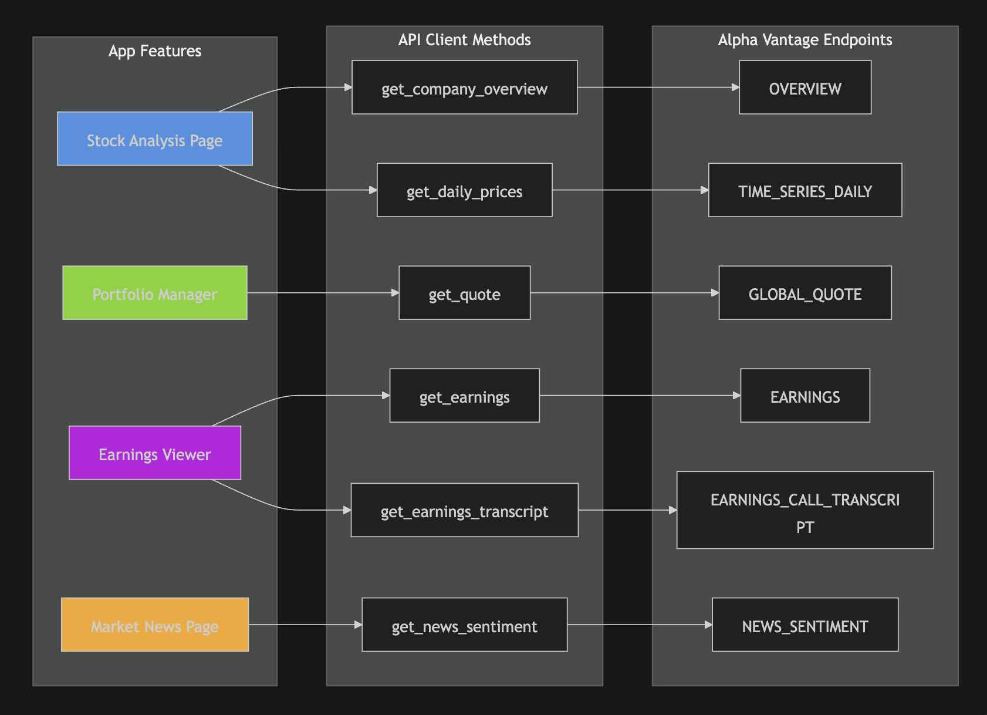

Slide 16
Iteration 2 - Data & Analysis Core (Oct 21 – Nov 3)
Develop Stock Analysis Service (data ingestion + metrics)
Stand up Portfolio Management Service (link to user data)
Implement data persistence redundancy and validation logic
Connect market data APIs

Slide 17
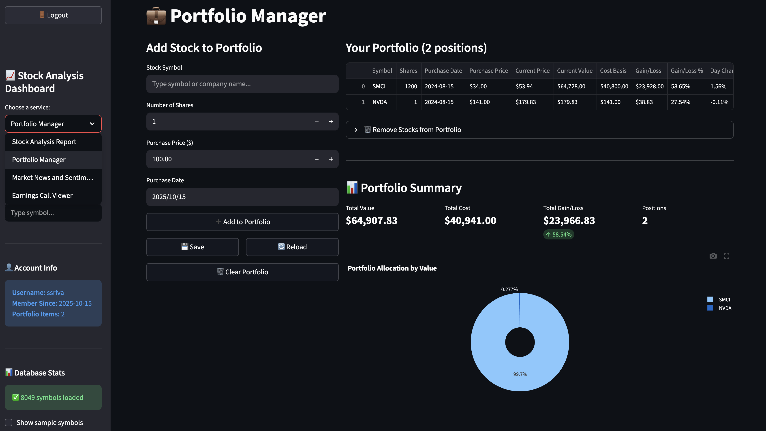

Slide 18
Iteration 3 – Intelligence & Alerts (Nov 4 – Nov 17)
Build Market News & Sentiment Service (API)
Develop Alert & Notification Service (event-driven triggers)
Enable low-latency data delivery for dashboards
Integrate fault tolerance, retry logic, and caching

Slide 19
Iteration 4 – Integration & Finalization (Nov 18 – Dec 1)
Deploy MVP and document APIs for next phase
Integrate all microservices end-to-end
Harden security and authentication flows
Conduct load testing and performance tuning

